Slide 1
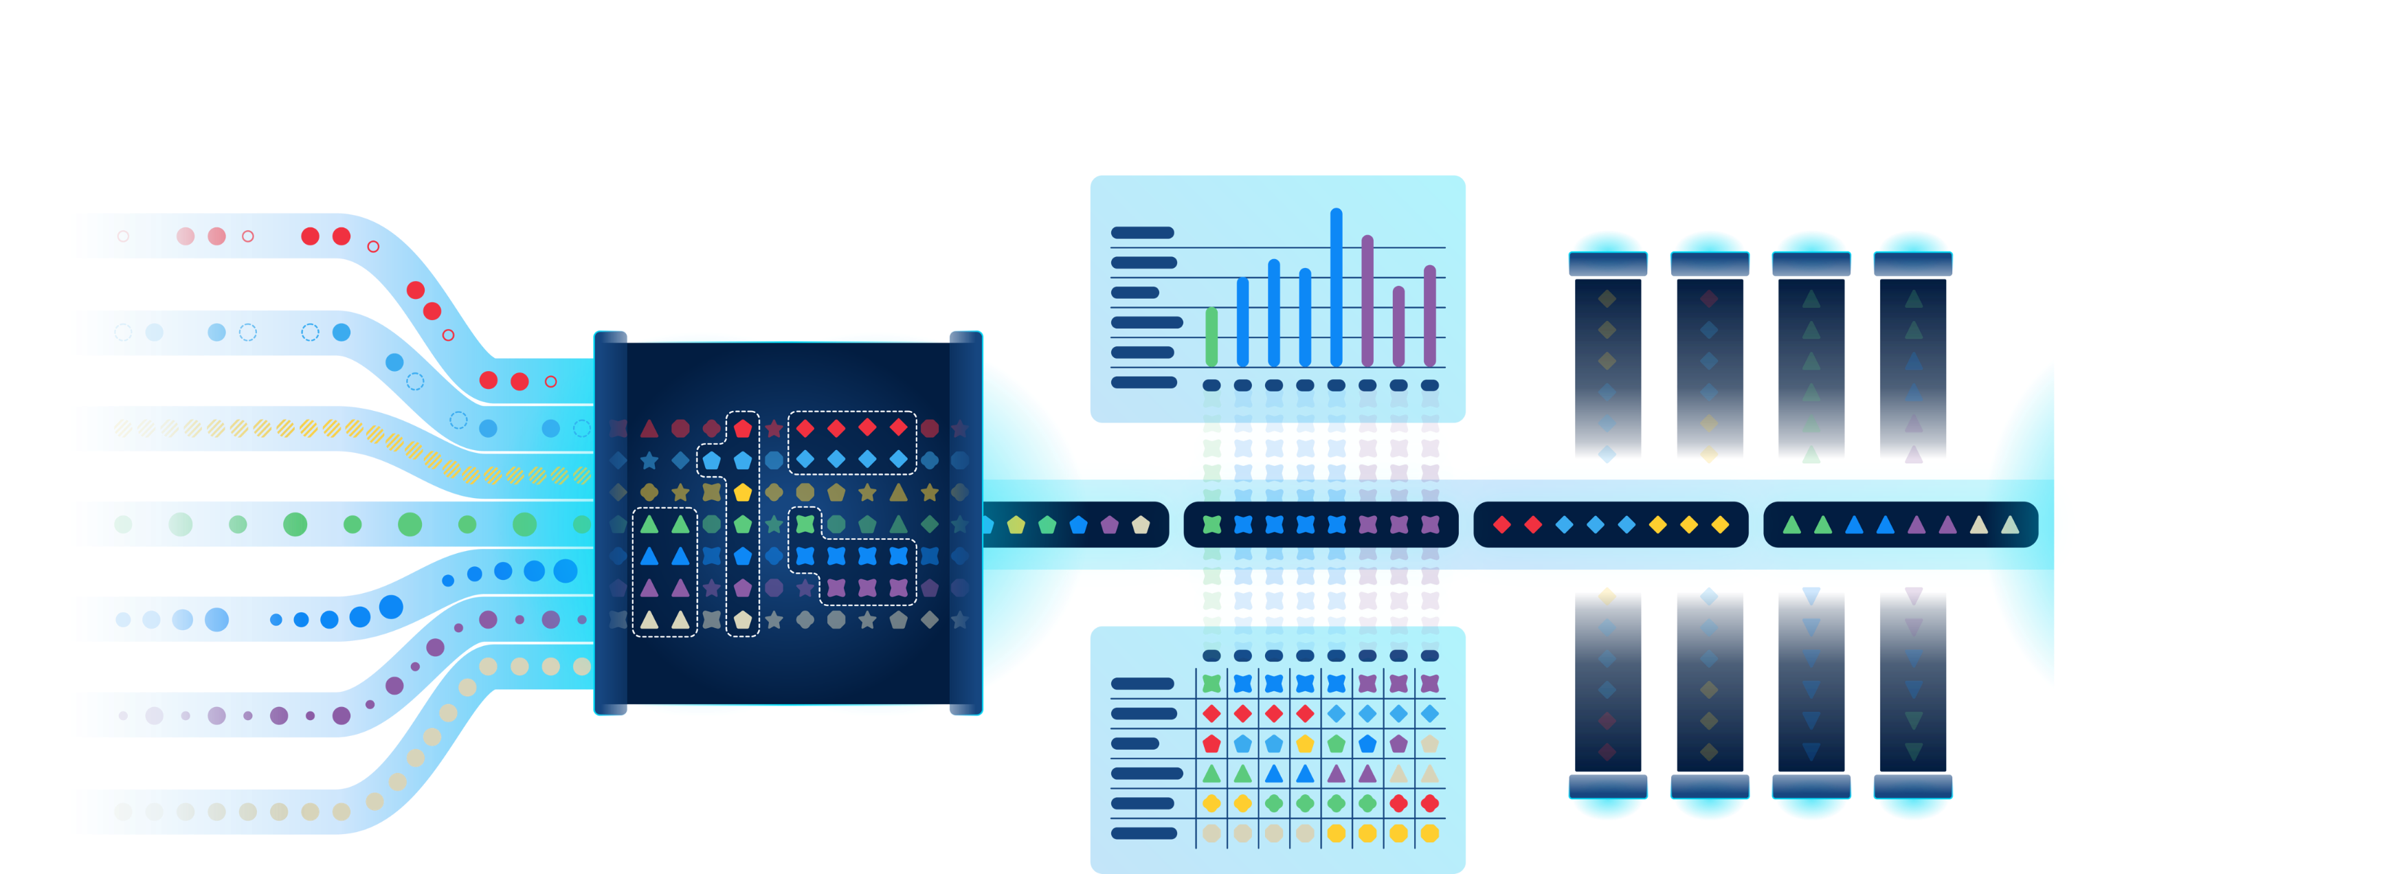

The Sight Machine Offering: Structuring Data Is at the Core
Data transformation is automated, early, and universal. Highly variable plant floor data is ingested, labeled, continuously structured
into four common building blocks of information (Data Foundation), associated into models (twins), and analyzed in real time
Connect
Securely ingest
all plant data
Transform
Automate data
transformation
Analyze
Analyze transformed data
with pre-built twins, apps,
AI, out-of-box GenAI
Build
Share transformed data
with other applications
Results
Make data useful
for all stakeholders
Energy, Weather, Cost
ERP
MES
Historians
Quality
Materials Data
Controls/Automation
Stateful, domain-oriented transforms
Low code/no-code
Automated feature generation for AI
WMS
SCM
MRP
Production Planning
Operations Leaders
Process Engineers
Operators
IT Managers
Data Scientists
Supply Chain
Sustainability
Connected Machines/ After-sales Service
Value Chain: Cross-firm
S&OP
ML Ops
CMMS
CRM
Data Foundation
Four domain-specific schemas

Slide 2



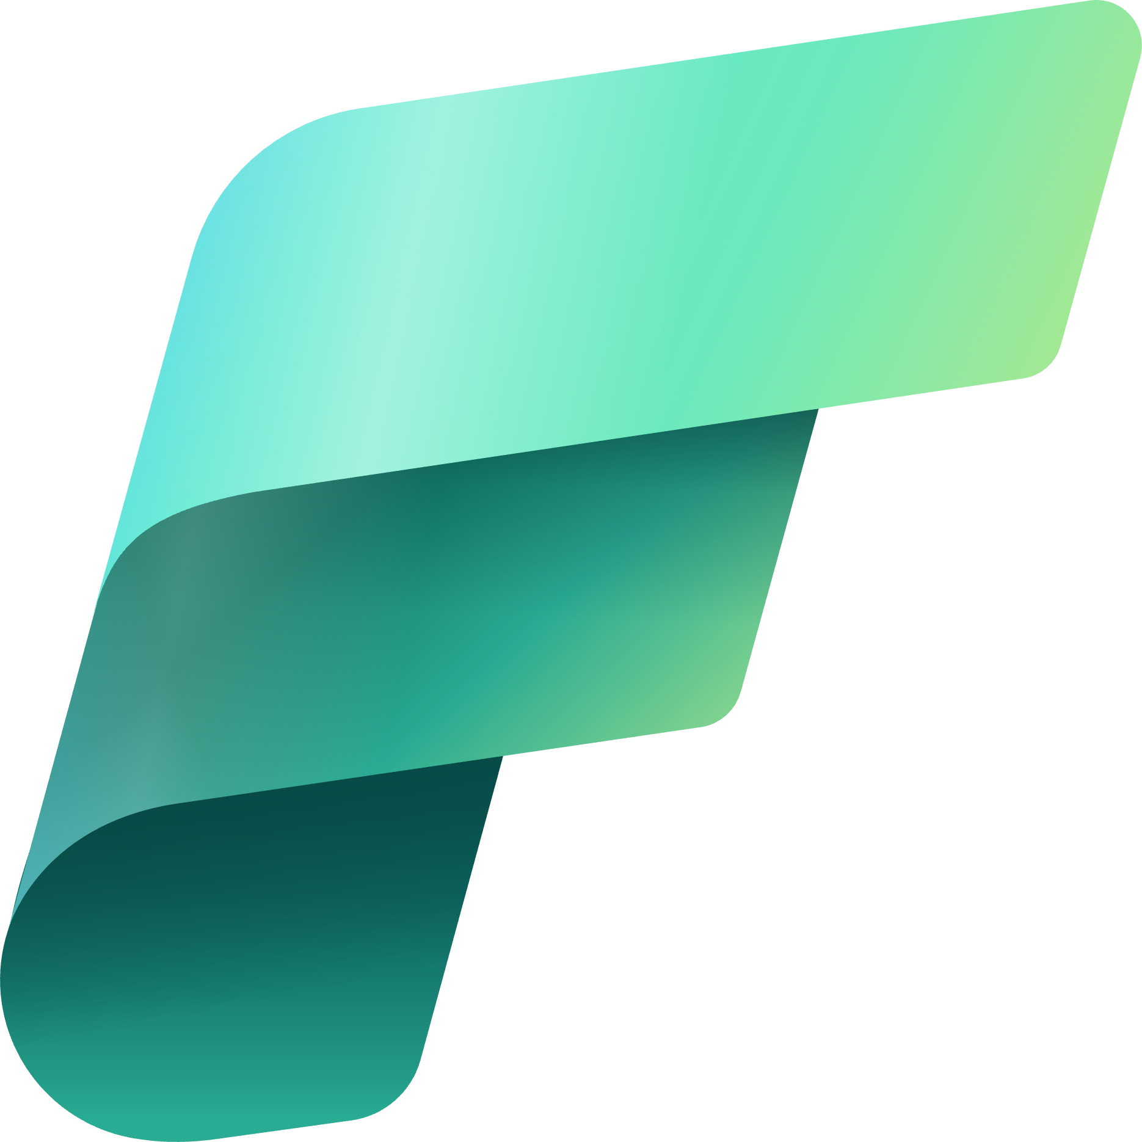
Agents Are Used Both to Implement and Scale (Infrastructure Agents) and to Optimize and Analyze through Orchestration (Copilots)
Infrastructure Agents
Manufacturing Optimizaton
Engineering Presentation
Real-Time
App Coder
Manufacturing
Simulation
Pipeline Update
Copilots
Namespace
Enterprise Orchestration: Supply Chain
& Production
Map & Label
Microsoft 365
NVIDIA Omniverse
Domain-Specific Language Models
Enterprise Orchestration: Energy
Enterprise Orchestration: Match Demand
& Make
Connect
Transformers
Azure AI Foundry
NeMo Agent Toolkit
Microsoft Fabric
Data Foundation
Consistently structured data
Domain Expertise
Data, templates, applications

Slide 3
Orchestration through LLMs
Infrastructure Agents
Manufacturing Optimizaton
Engineering Presentation
Real-Time
App Coder
Manufacturing
Simulation
Pipeline Update
Copilots
Namespace
Enterprise Orchestration: Supply Chain
& Production
Map & Label
Microsoft 365
NVIDIA Omniverse
Domain-Specific Language Models
Enterprise Orchestration: Energy
Enterprise Orchestration: Match Demand
& Make
Connect
Transformers
Azure AI Foundry
NeMo Agent Toolkit
Microsoft Fabric
Data Foundation
Consistently structured data
Domain Expertise
Data, templates, applications

Slide 4
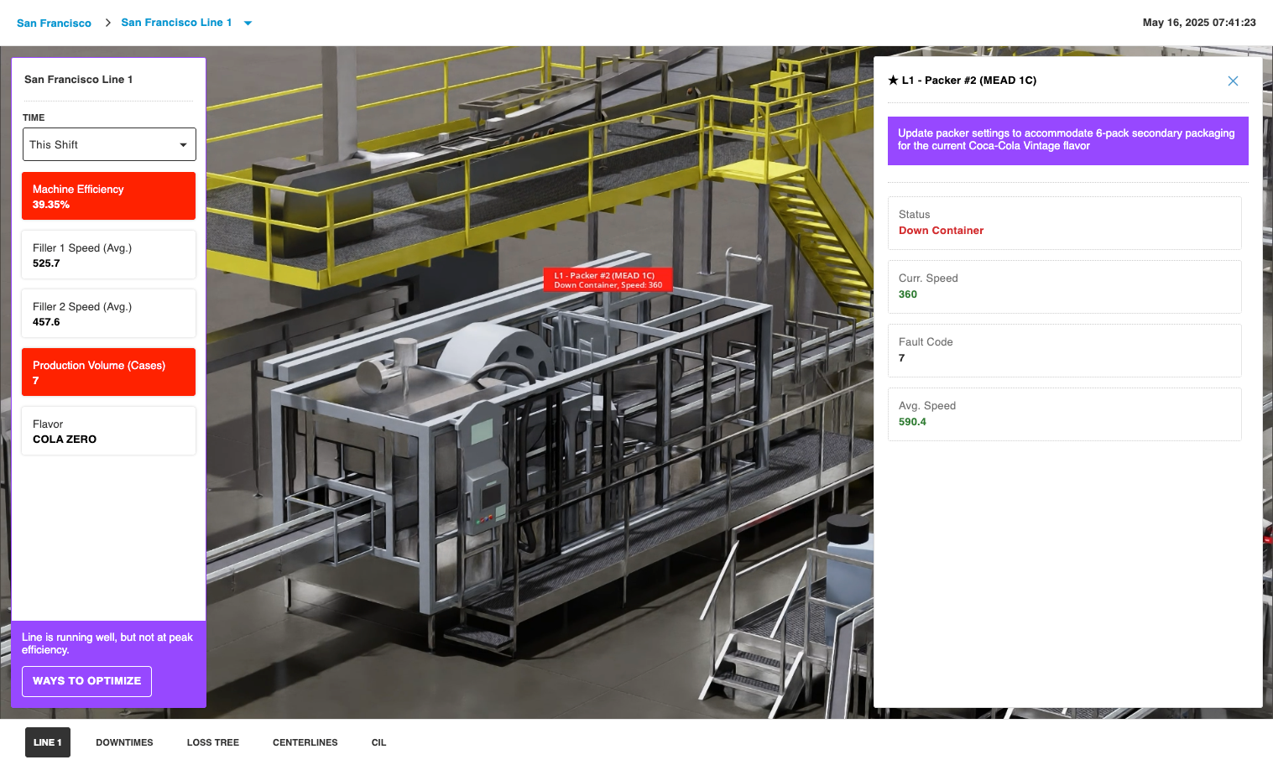
Operator Agent: Representative Use of Agents and 3D
The Microsoft, NVIDIA + Sight Machine Joint Solution Delivers Value in Weeks
Real-world Results
Initial Outcomes in Weeks
20% Improvement to profitability in a leading packaging manufacturer’s first plant. This manufacturer is now using the platform in 10+ plants
78% Reduction in defects from glass furnace
$750k/line/year In avoided downtime through prediction and avoidance of VFDs failure at bottling plant

