Slide 1
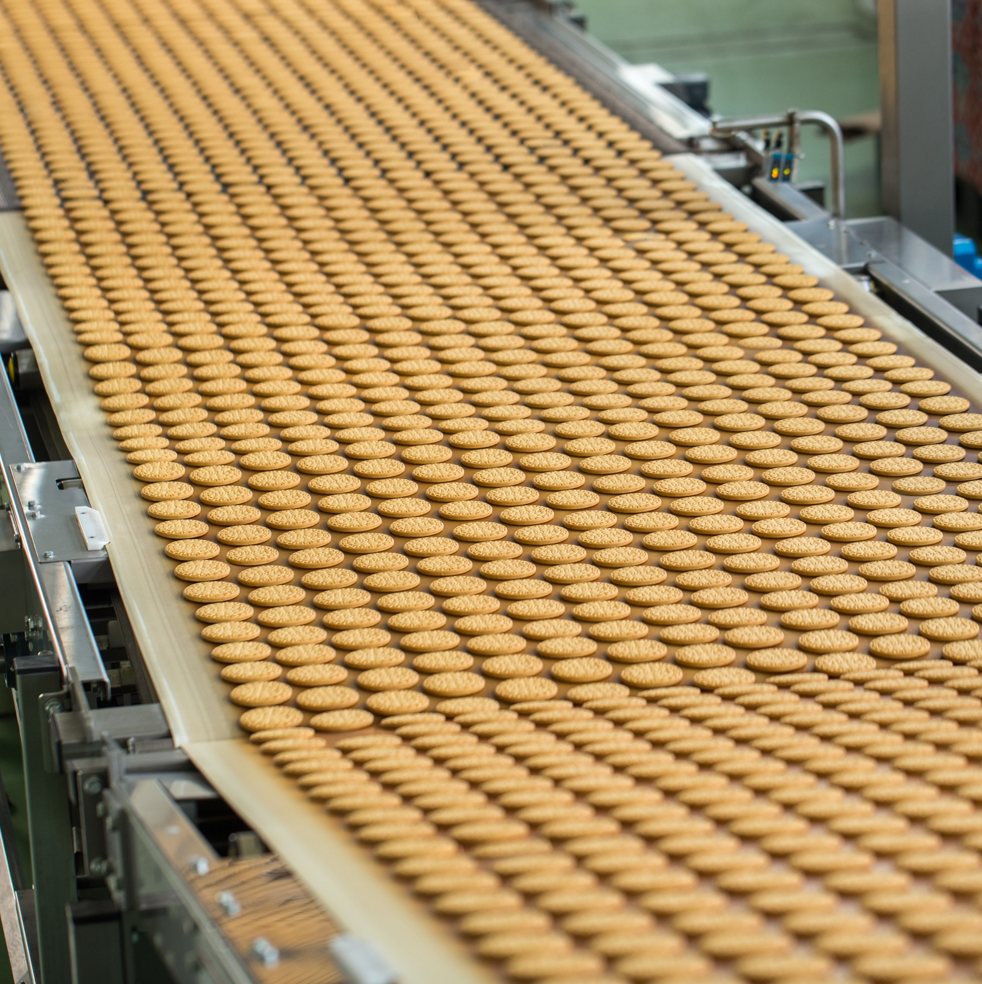
Representative Industry:
Food Manufacturing
Visualize & Analyze
Overfilling
Enable real-time feedback on filling accuracy and management of packaging
Visualize & Analyze
Loss Trees
Show where losses are occurring in both process areas and packaging
AI Application
Dynamic Recommendations
Set production parameters to match raw material and environmental conditions
AI Application
Root Cause of Yield Losses
Identify from thousands of parameters which are causal for real-time RCA of yield losses
Edge Infrastructure
IoT Operations
Leverage IoT Operations as key infrastructure element for edge architecture
Visualize & Analyze
Efficiency by SKU
Associate cost, energy information by SKU, and optimize plant production
Visualize & Analyze
Optimize Line Speed
for Stability and Yield
Identify the best line speeds by SKU.
Identify opportunities to increase line speed

Slide 2
Structure Once. Analyze Infinitely.
Unified Data Foundation Enables AI Across All Manufacturing Use Cases
 | Visibility What’s happening? | Variation What’s changing? | Cause What’s the cause? | Rule What’s the rule/recipe? | Prediction What will happen? | Prescription What steps to take now? | Optimization How to optimize the system?
Throughput
Availability
Rate
Global Ops View
Asset Throughput Comparison
Ramp Up Efficiency
After Product CIP
or Changeover
Real-time Inventory
Control and Tracking
Packaging Fault
Code Triage
Predictive
Downtime
Packaging
Microstops
Reduction
Cookbooks
and Recipe
Quality
Top Defect Pareto
Daily Meeting Yield Dashboards
Dimension
Consistency
Batch Production
Consistency
(e.g., Fermentation)
Set Points for Raw
Material Seasonal
Change/Mix
(e.g., Grains, Dairy)
Allowance for
Environment
(e.g.,Winter vs.
Summer, Humidity)
Prescriptive
Quality
Quality Optimizer, Cookbooks
and Recipe
Descriptive Statistics
Statistical Inference
AI/ML
Cost
Energy
Materials
Labor
Waste
Minimization /
Water and Utilities
Minimization
Cost
Tracker
Material Reduction,
Defect Analysis
Cooker/Fryer/Steamer
Energy Reduction
Predictive
Cost
Prescriptive Material Consumption
Overpack
Reduction
Flexibility
Changeover
Process Changes
Mix
Changeovers,
Network-wide
Capacity
HACCP
Compliance
Root Cause
Changeover Delays
Scheduling and
Line Balancing
Predictive
Changeover
Viable Scrap
Reblend Consistency
and Optimization
Clean in Place
(Changeover + Cost)

