Slide 1
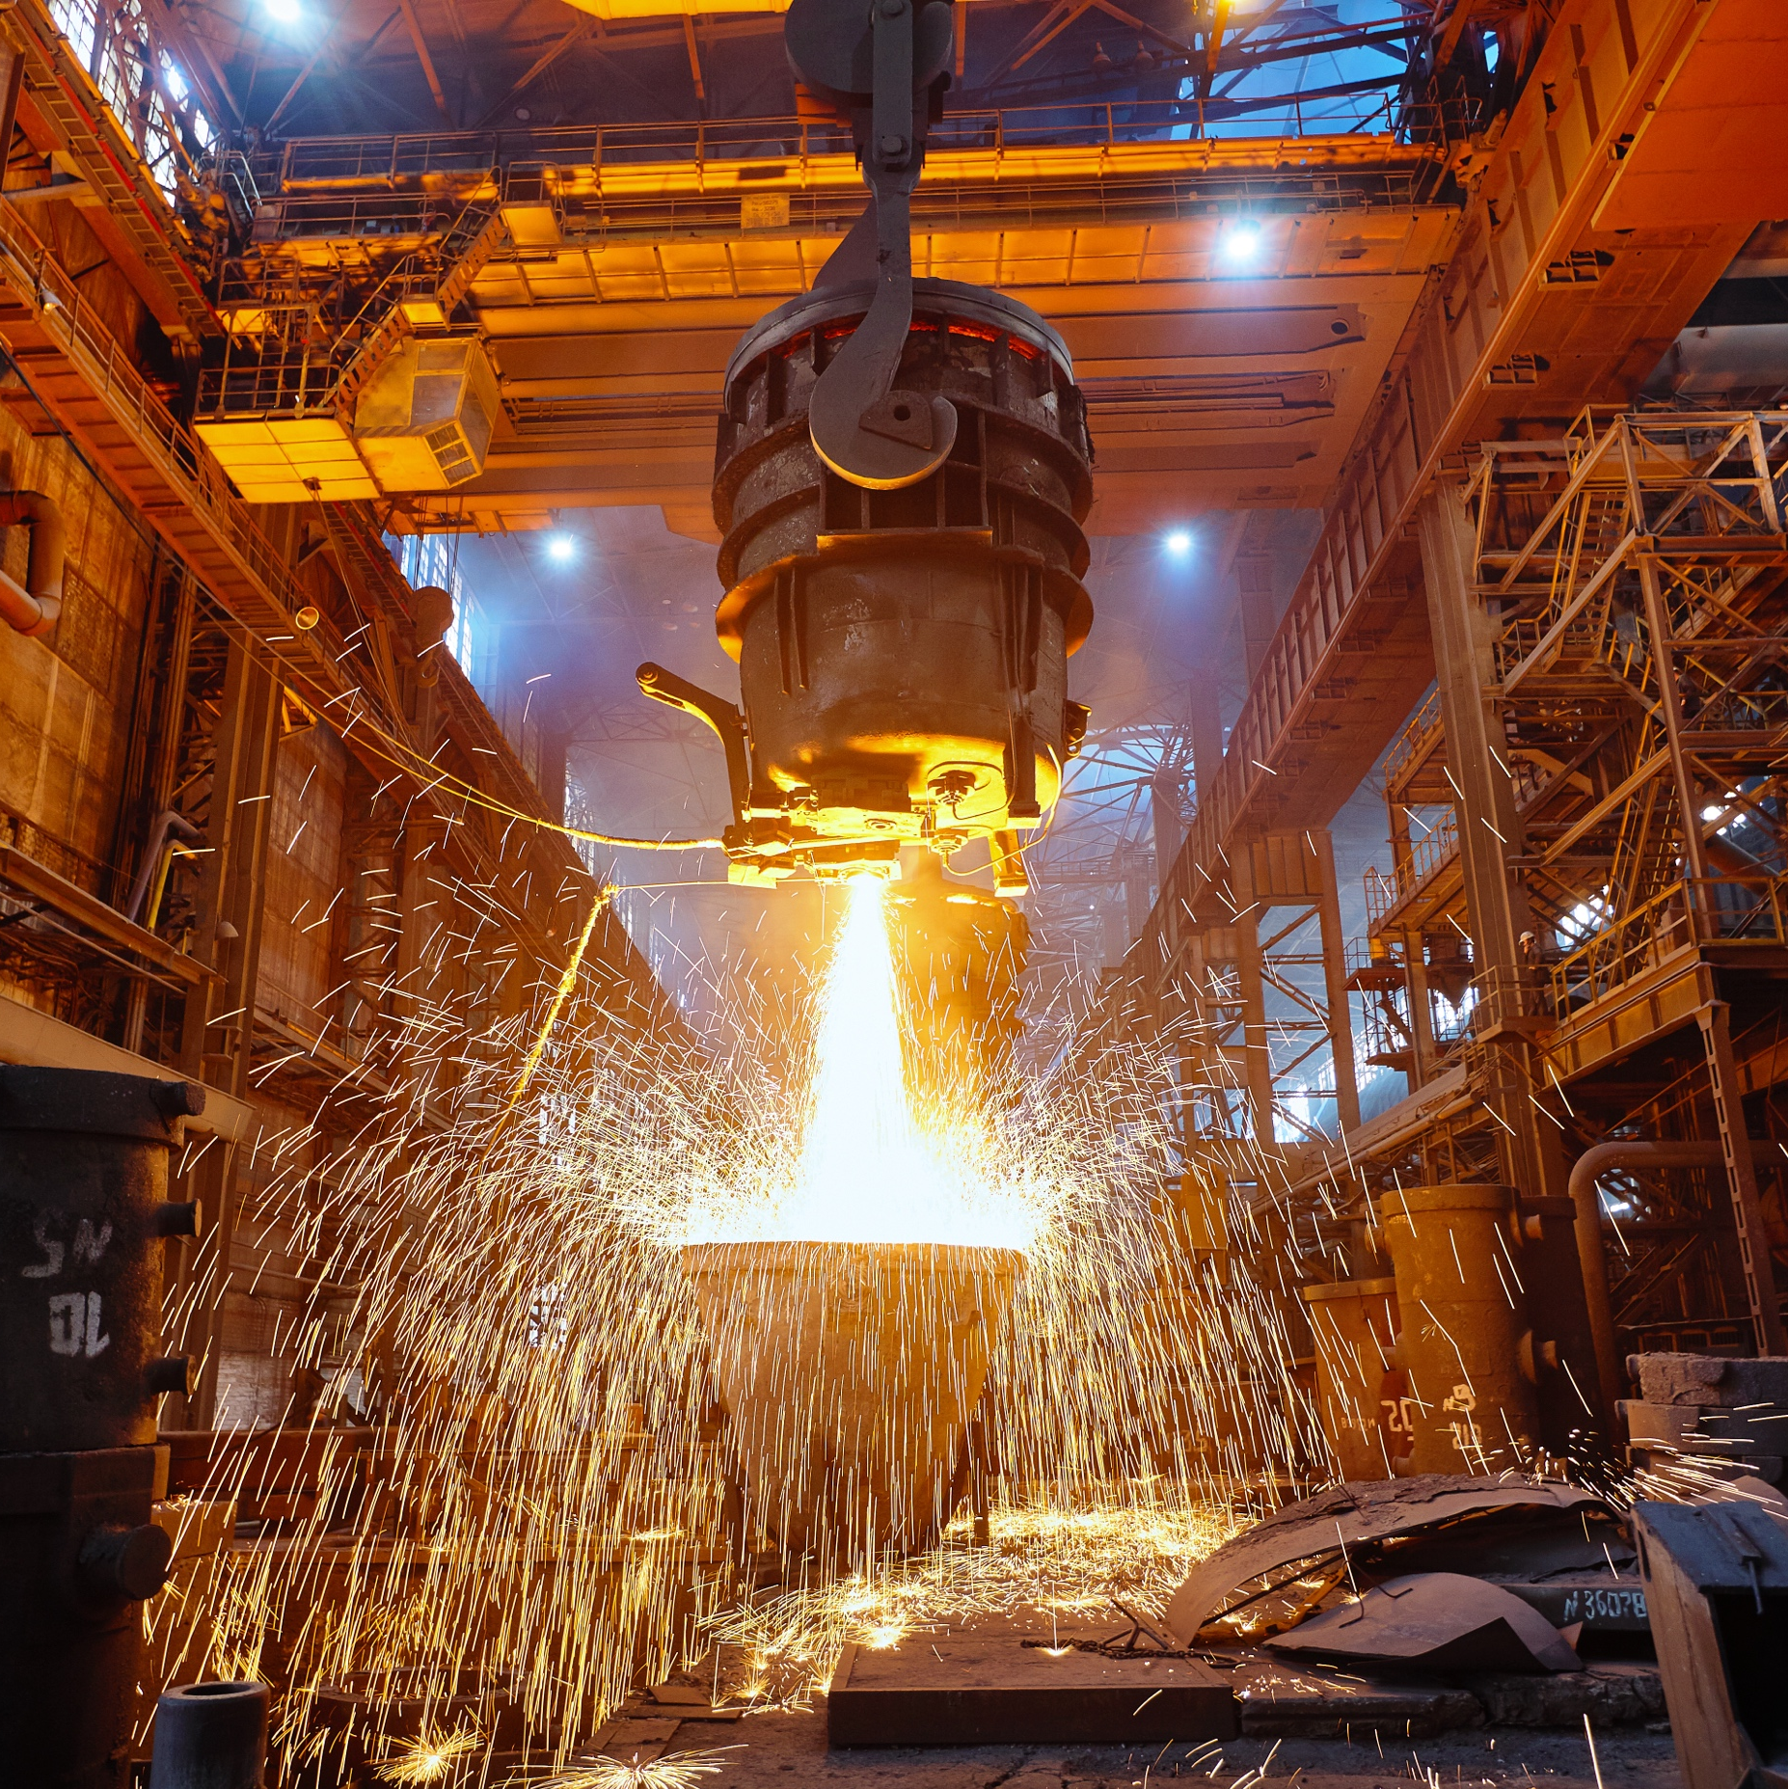
Representative Industry:
Metals and Heat-Intensive Production
Visualize & Analyze
3D Visualization
Real-time 3D view of furnace operations with 3D scenes leveraging data from Sight Machine
Copilot
Enterprise Use Cases
Leverage manufacturing data to develop Copilots for enterprise-wide use cases. Examples: Marketing, supply chain
AI Application
Prescriptive Quality
Prescriptive recommendations for operators based on prediction of quality 2-3 days into the future
AI Application
CO₂ Reduction
AI applications to optimize CO₂ emissions per unit of saleable product
Visualize & Analyze
CO₂ Footprint
Real-time measurement of CO₂ footprint
Visualize & Analyze
Energy Optimization
Optimize temperature settings to reduce energy usage while maintaining high product quality

Slide 2
Structure Once. Analyze Infinitely.
Unified Data Foundation Enables AI Across All Manufacturing Use Cases
 | Visibility What’s happening? | Variation What’s changing? | Cause What’s the cause? | Rule What’s the rule/recipe? | Prediction What will happen? | Prescription What steps to take now? | Optimization How to optimize the system?
Throughput
Availability
Rate
Global Ops View
Asset Throughput Comparison
OEE and
KPI Tracker
Alarm
Analysis
Centerline
Analysis
Predictive
Downtime
Prescriptive
Uptime
Cookbooks
and Recipe
Quality
Top Defect Pareto
Daily Meeting Yield Dashboards
Yield
Tracker
Root Cause
Yield
Centerline Analysis:
Recipe Setting
Predictive
Yield and Energy
Efficiency
Prescriptive
Quality
Quality Optimizer, Cookbooks
and Recipe
Descriptive Statistics
Statistical Inference
AI/ML
Cost
Energy
Materials
Labor
Materials
Usage
Cost
Tracker
Material Reduction,
Defect Analysis
Yield and Rework
Optimization
Predictive
Cost
Prescriptive Material Consumption
Energy, Quality Optimization
Flexibility
Changeover
Process Changes
Mix
Changeovers,
Network-wide
Capacity
Changeover
Variation,
Network-wide
Capacity Tracking
Root Cause
Changeover Delays
Run-specific
Recipes
Predictive
Changeover
Prescriptive
Changeover
Schedule
Clean in Place
(Changeover + Cost)

