Slide 1




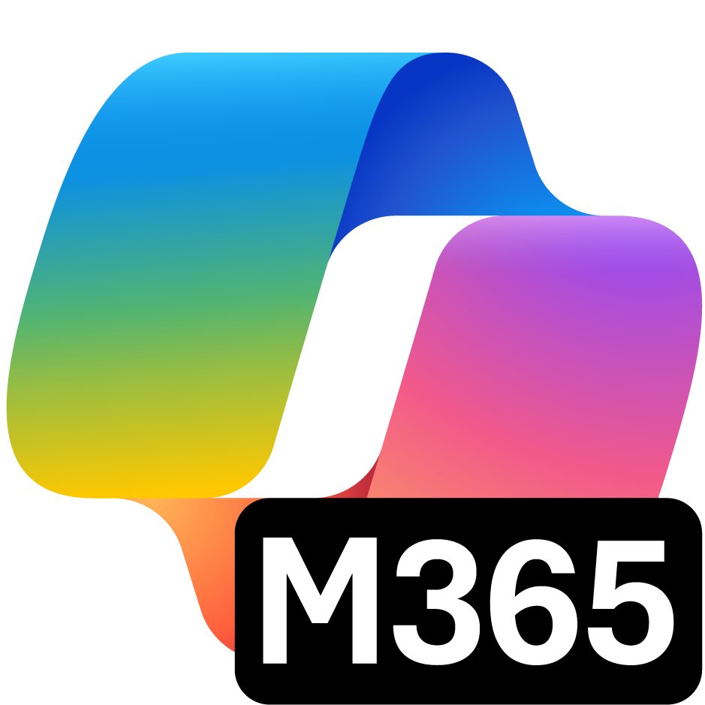



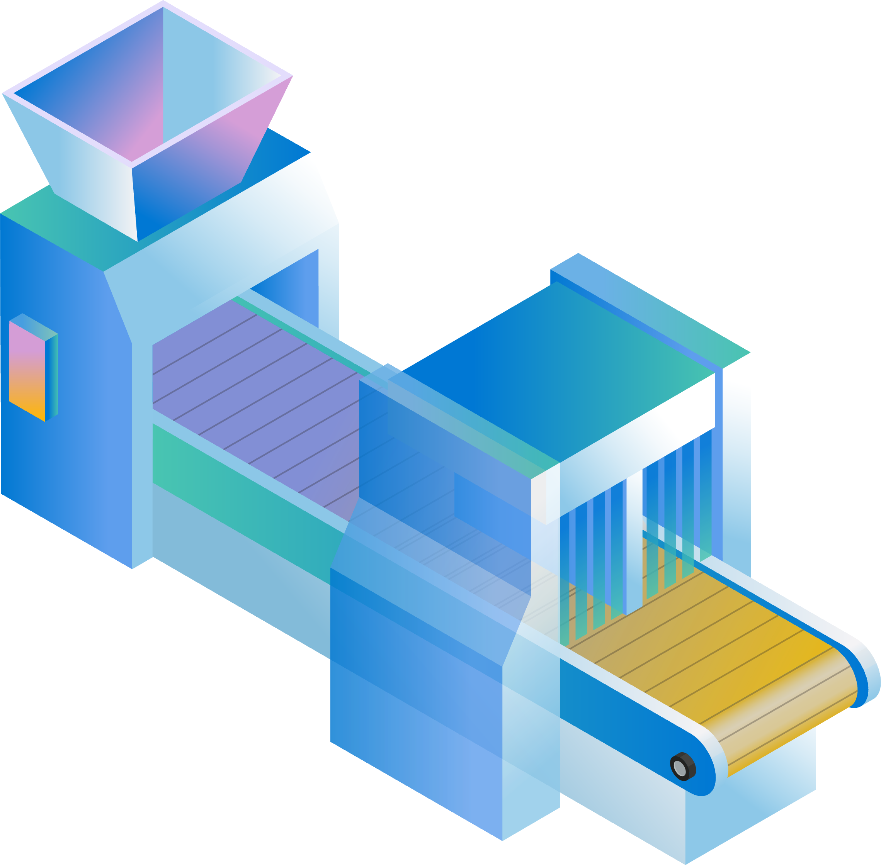
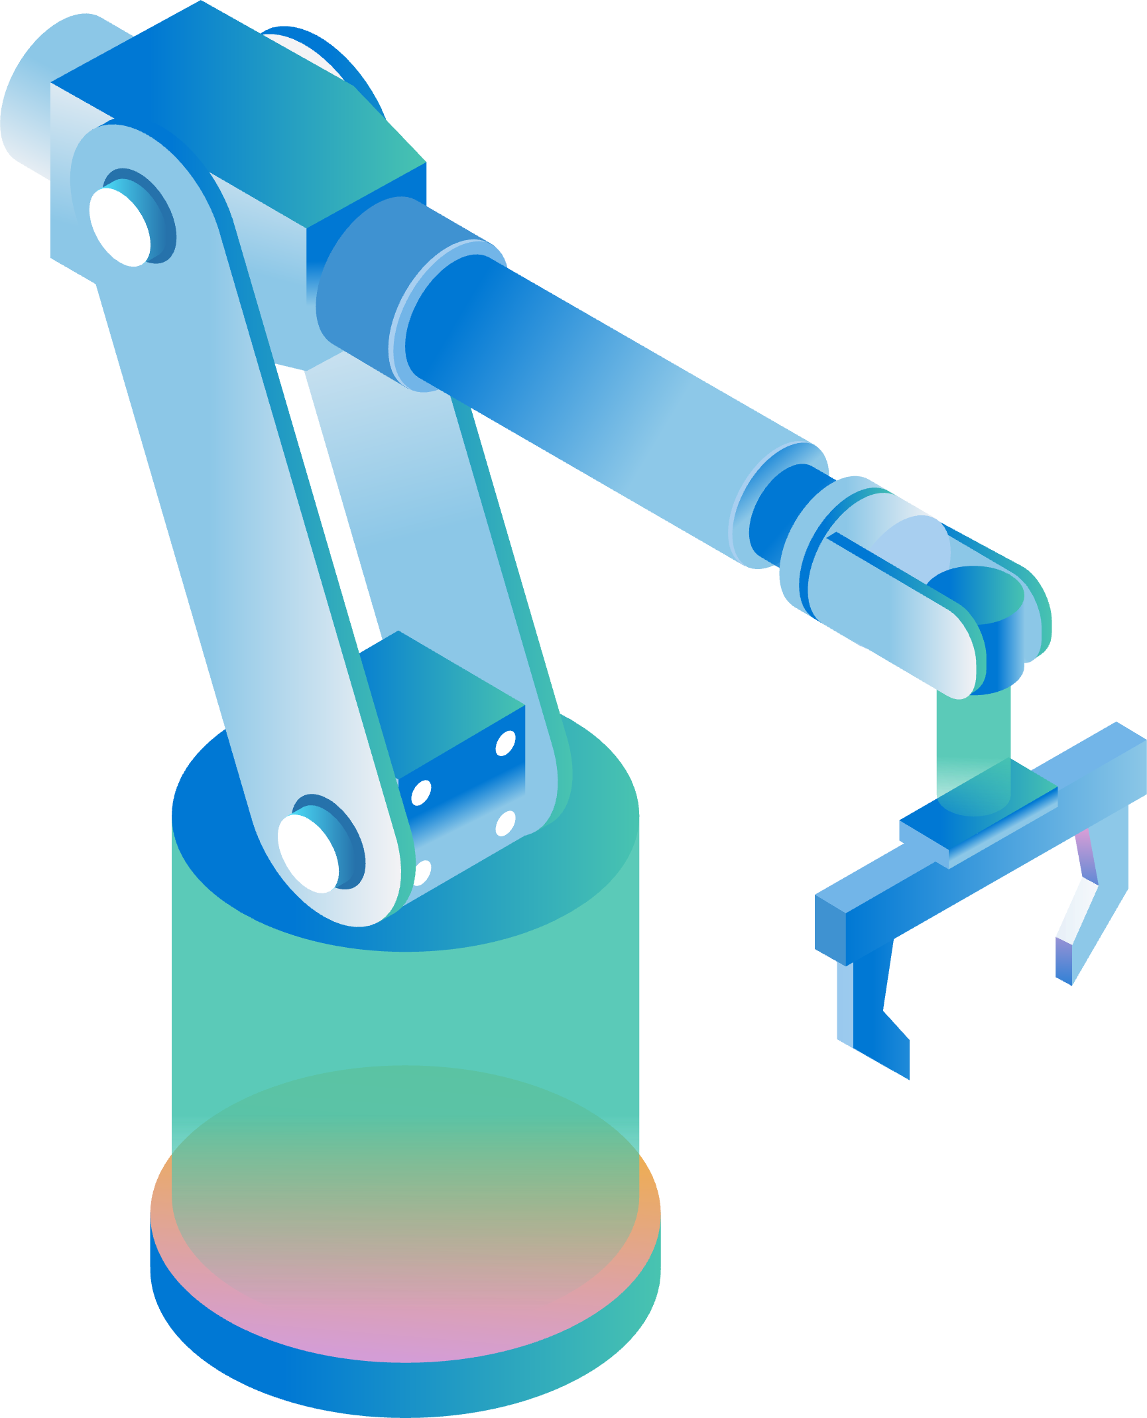
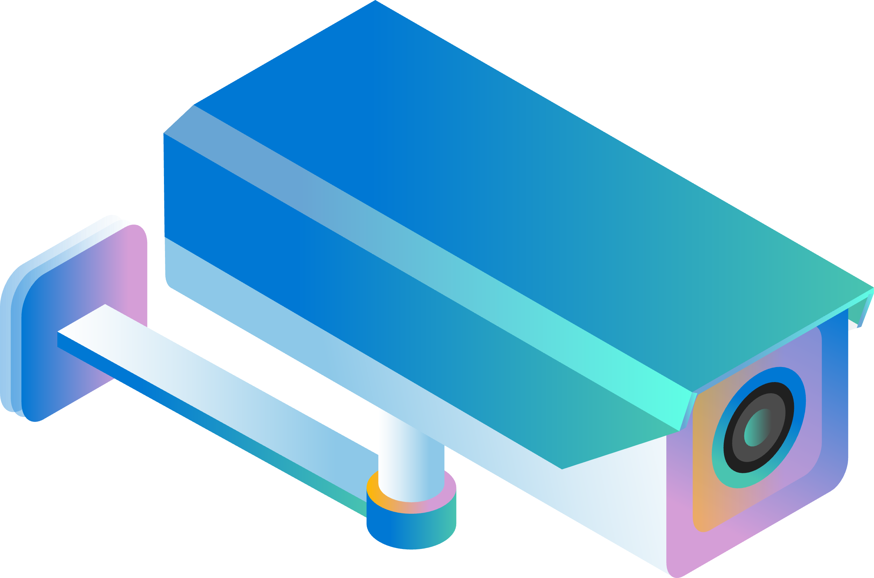

Joint Solution Architecture with Microsoft
Data Sources
Edge
Cloud
IT
Industrial AI
Apps & Agents
PLM
MES
QMS
Fabric
RTI
ERP
Azure IoT Operations
Apps
Operations
Bronze
Layer
Silver
Layer
Gold
Layer
Digital Twin Builder
SCADA
HMI
Agents
IOT
Historians
Connect
Structure
Digital
Twins
Equipment
Analyze
Operate
Arc-enabled Kubernetes

